Slide 1

BACHELOR OF TECHNOLOGY
IN
Artificial Intelligence and Machine Learning
Application Development –Deep Learning Explore ( MR22-1CS0203)
Section : AIML-Theta
Project Title : UPI FRAUD DETECTION USING DEEP LEARNING
Batch Number: TT-2
Roll Numbers :
Project Guide : Prof A.Kalyani (MRUE2204T085)
Department of AIML, School of Engineering
Malla Reddy University
2211CS020442
2211CS020444
2211CS020446
2211CS020450
2211CS020492

Slide 2
Abstract
The surge in UPI-based digital payments has been accompanied by a parallel increase in fraudulent activities, posing significant financial risks. This research investigates the application of deep learning models, specifically Long Short Term Memory (LSTM) and Autoencoders, for real-time detection of fraudulent UPI transactions. LSTM, owing to its ability to capture sequential dependencies, is employed to analyze transaction patterns over time, identifying anomalies indicative of fraudulent behavior. Conversely, Autoencoders are utilized to learn a compressed representation of normal transactions, enabling the detection of deviations through reconstruction errors. By combining the strengths of both models, a robust fraud detection system is developed. Experimental results demonstrate the efficacy of the proposed approach in accurately identifying fraudulent transactions, thereby enhancing the security of UPI payments and mitigating financial losses.

Slide 3
Literature
Research Existing Solutions and Approaches
Deep Learning in Fraud Detection: Explore how deep learning techniques, particularly LSTM and Autoencoders, have been employed in fraud detection across various domains (e.g., credit card fraud, insurance fraud, and network security).
Fraud Detection in UPI Transactions: Investigate existing works specifically focused on UPI transactions. Consider studies that use other machine learning models, like Random Forests or Support Vector Machines (SVM), and compare their effectiveness to deep learning models.
Technical Requirements and Constraints
Data Availability: Discuss the need for high-quality, labeled data containing fraudulent and non-fraudulent UPI transactions to train your models effectively.
Real-Time Processing: Given the real-time nature of UPI transactions, highlight the importance of having a model that can analyze data quickly and provide results in a timely manner.

Slide 4
Literature
Scalability: Explore the need for a scalable system that can handle large volumes of transactions as UPI usage continues to grow.
Anomaly Detection Sensitivity: Discuss how your model should balance sensitivity (detecting fraudulent transactions) with specificity (minimizing false positives).
Steps and Components for Your Application
Data Collection and Preprocessing: Outline how to collect UPI transaction data and clean it for training, validation, and testing.
Model Selection and Development: Explain why you’ve chosen LSTM and Autoencoders, and how each model addresses different aspects of fraud detection (sequential dependencies and anomaly detection).
Model Training and Evaluation: Detail the process of training your models, including splitting data into training and testing sets, fine-tuning hyperparameters, and selecting evaluation metrics (e.g., precision, recall, F1-score).

Slide 5
Problem Statement
Problem:
The primary challenge is to develop an advanced fraud detection system that can accurately identify and prevent fraudulent UPI transactions in real-time. Existing systems may struggle with high false positives or fail to detect novel fraud patterns due to their reliance on static rules and manual updates.
Objective:
To design and implement a deep learning-based fraud detection system for UPI transactions that improves the accuracy and efficiency of fraud detection, minimizes false positives, and adapts to emerging fraud patterns. The system should be capable of:
> Real-Time Detection , High Accuracy, Adaptability, Scalability.
Constraints:
Data Privacy, Computational Resources, Integration.

Slide 6
Problem Statement
Expected Outcome:
A robust, deep learning-based fraud detection system that significantly improves the accuracy of UPI fraud detection, reduces the incidence of false positives and negatives, and adapts to new fraud techniques. The system should enhance the security of UPI transactions and provide users with greater confidence in the safety of their digital payments.

Slide 7
Data Collection and Exploration
1. Data Source:
The dataset is sourced from historical UPI transactions stored in a CSV file.
2. Exploratory Data Analysis (EDA):
Visualizations:
Transaction Amount Distribution: Compare fraud vs. non-fraud transactions.
Time Analysis: Detect fraud patterns over time (day, week).
3. Data Cleaning:
Handle missing values Replacing them and Remove duplicate records.
4. Feature Engineering:
Transaction time-based: Hour of the day, day of the week.
Transaction frequency: Number of transactions from the same UPI ID within short intervals

Slide 8
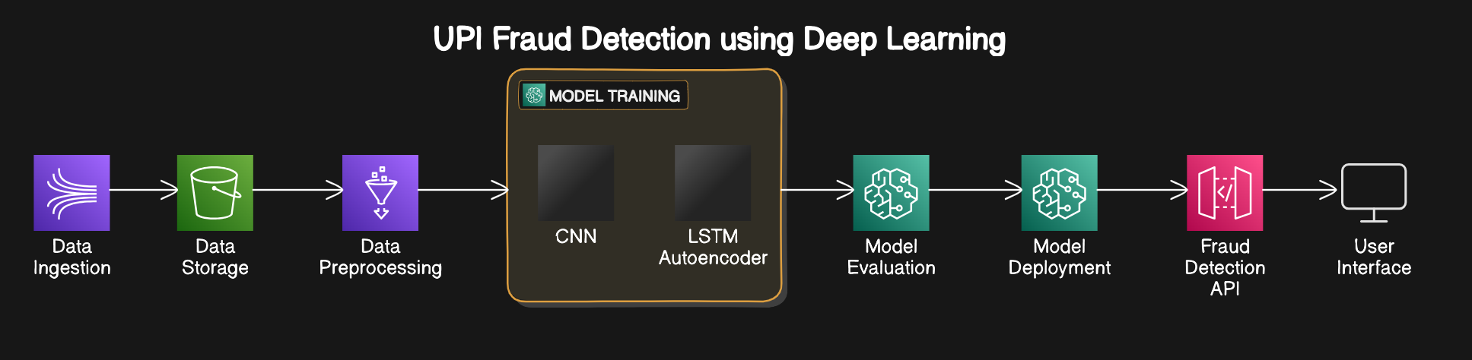
Model Selection and Architecture

Slide 9
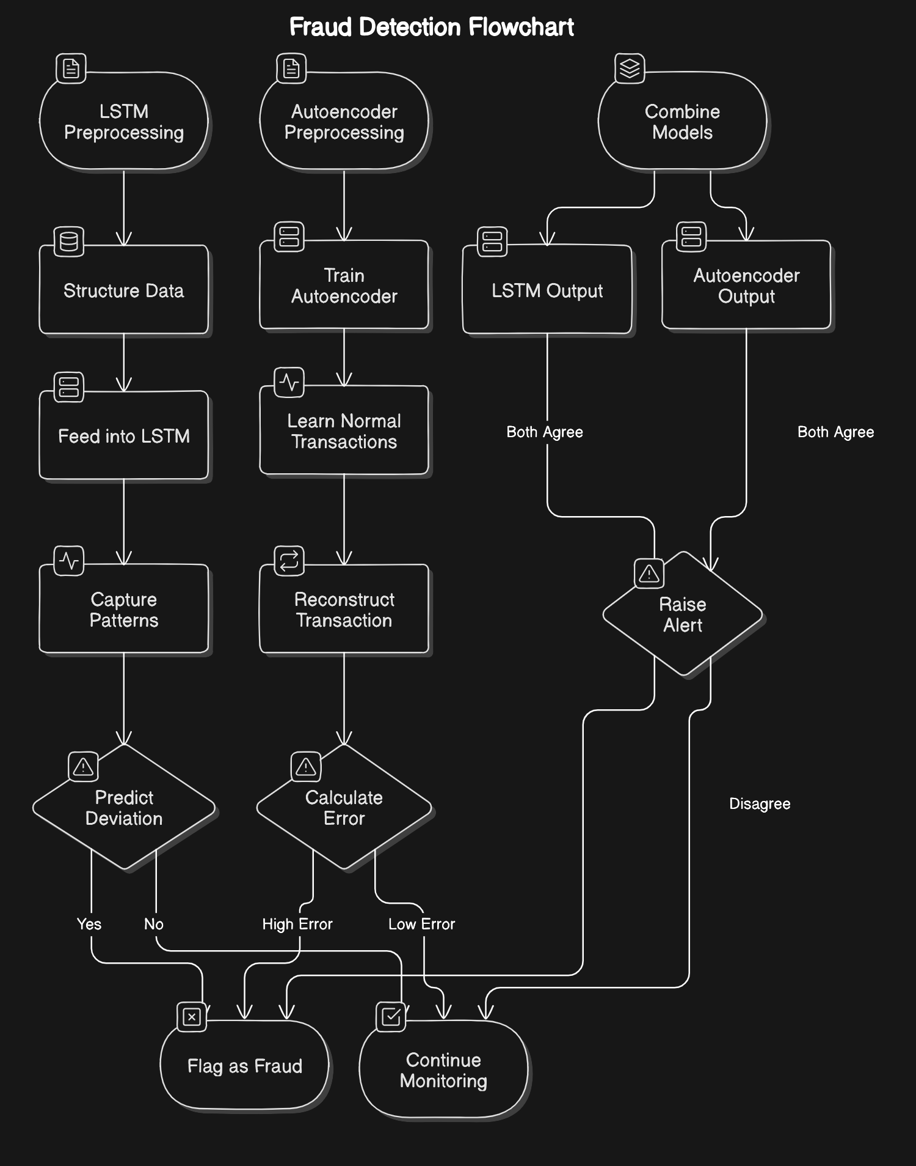
Model Selection and Architecture

Slide 10
Deployment & Results
Model Deployment:
Deployment Platform: Used cloud (e.g., AWS, Google Cloud) or on-premise. Serve with Flask, or Fast API.
Real-Time Integration: Connect to live UPI systems for fraud predictions.
Evaluation Metrics:
Accuracy: Correct classification rate.
Precision & Recall: Measures for true frauds in flagged transactions and detection rate.
F1 Score: Balances precision and recall.
Testing Data & Methodologies:
Testing Data: Use 20-30% of data for testing (mixed fraud and legit transactions).
Cross-Validation & Confusion Matrix: Validates model robustness and error breakdown.
Real-Time Monitoring: Continuous evaluation on live data.

Slide 11
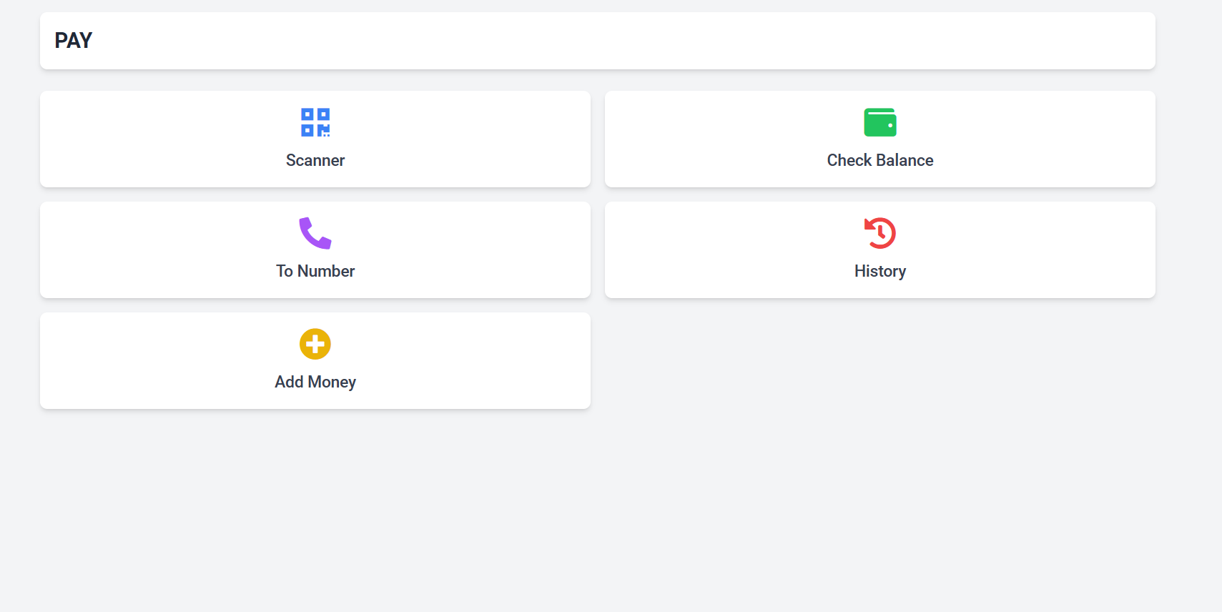
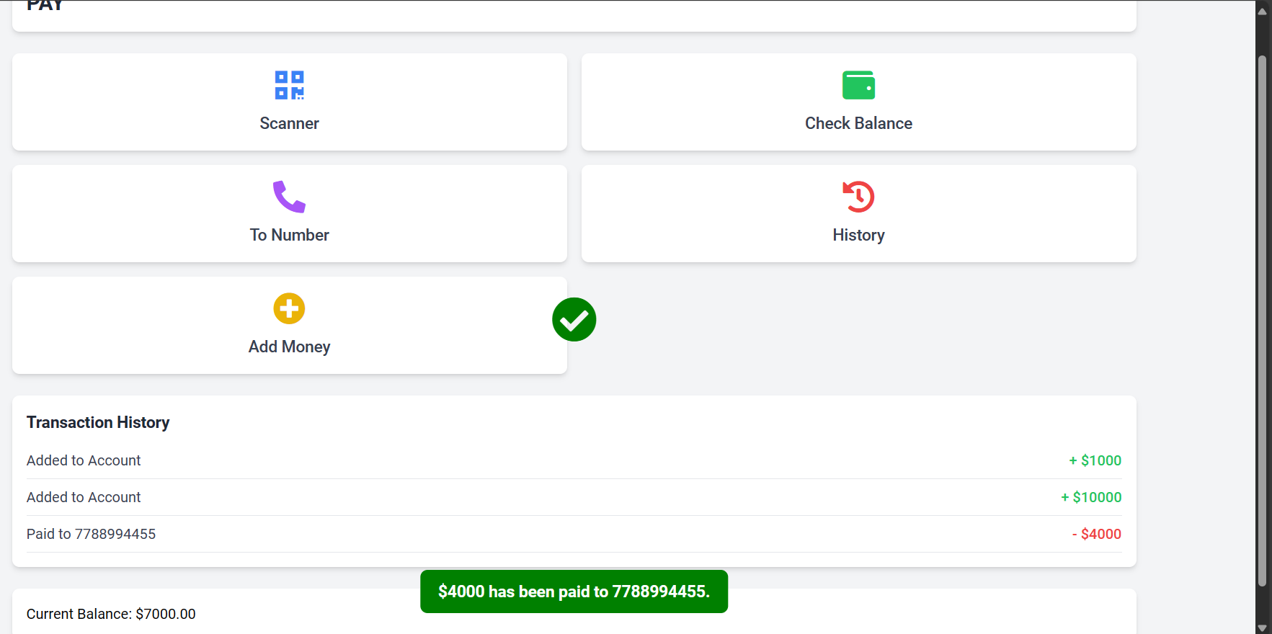
Deployment & Results

Slide 12
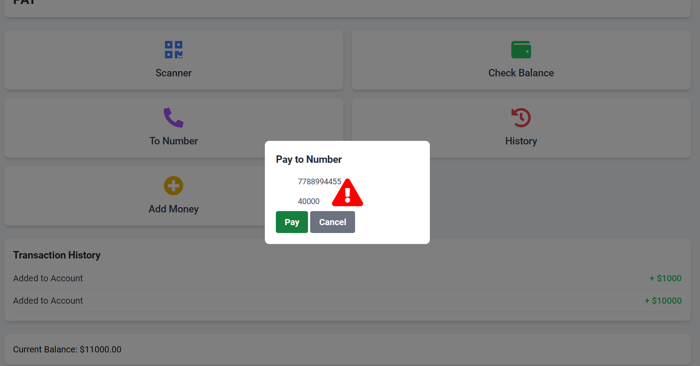
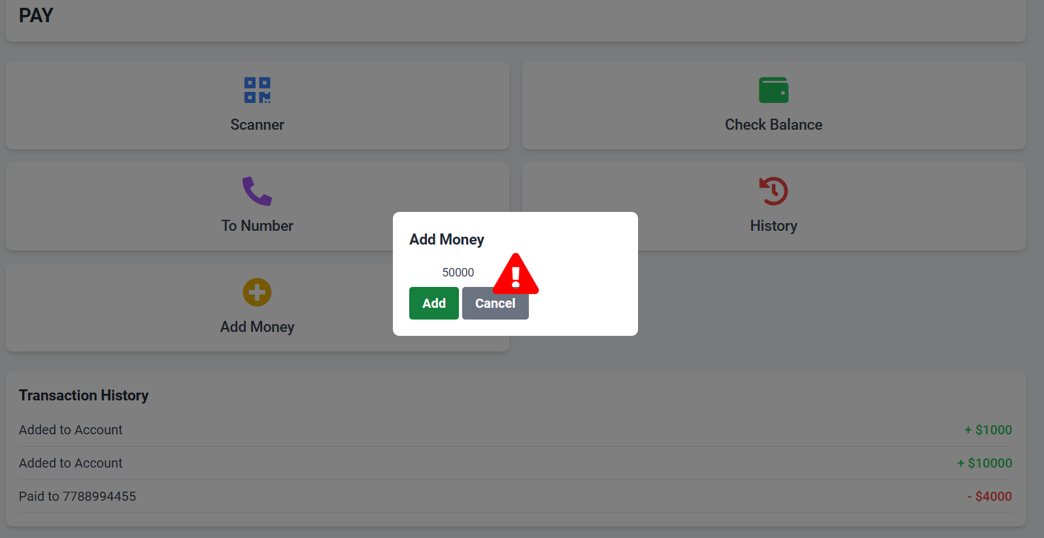
Deployment & Results

Slide 13
Conclusion
Using deep learning models like Autoencoders and LSTMs for UPI fraud detection enhances security by identifying complex fraud patterns with high accuracy. This approach strengthens real-time transaction monitoring, ensuring safer digital payments.
Future Scope:
Model Improvement: Combine models (e.g., Autoencoder + LSTM) for better accuracy and mainly focuses on improving the scanner for scanning the UPI ID’s.
Real-Time Adaptation: Use online learning to keep up with evolving fraud tactics.
Federated Learning: Collaborate across institutions for privacy-preserving fraud detection.
Explainability: Make models more interpretable for transparency.
Scalability: Optimize for high-speed, large-scale deployments.(like deployment in any type of UPI app.)

